Slide 1

Introduction to Cloud Computing
Introduction, Roots of Cloud Computing: From Mainframes to Cloud, Benefits of Cloud Computing SOA, Web services, Role of Networks in
Cloud Computing: Cloud types and service models, Primary Cloud
Service models, Cloud Services brokerage, Primary cloud deployment
models, cloud computing reference model, The greenfield and brownfield
deployment options, SLAs.

Slide 2
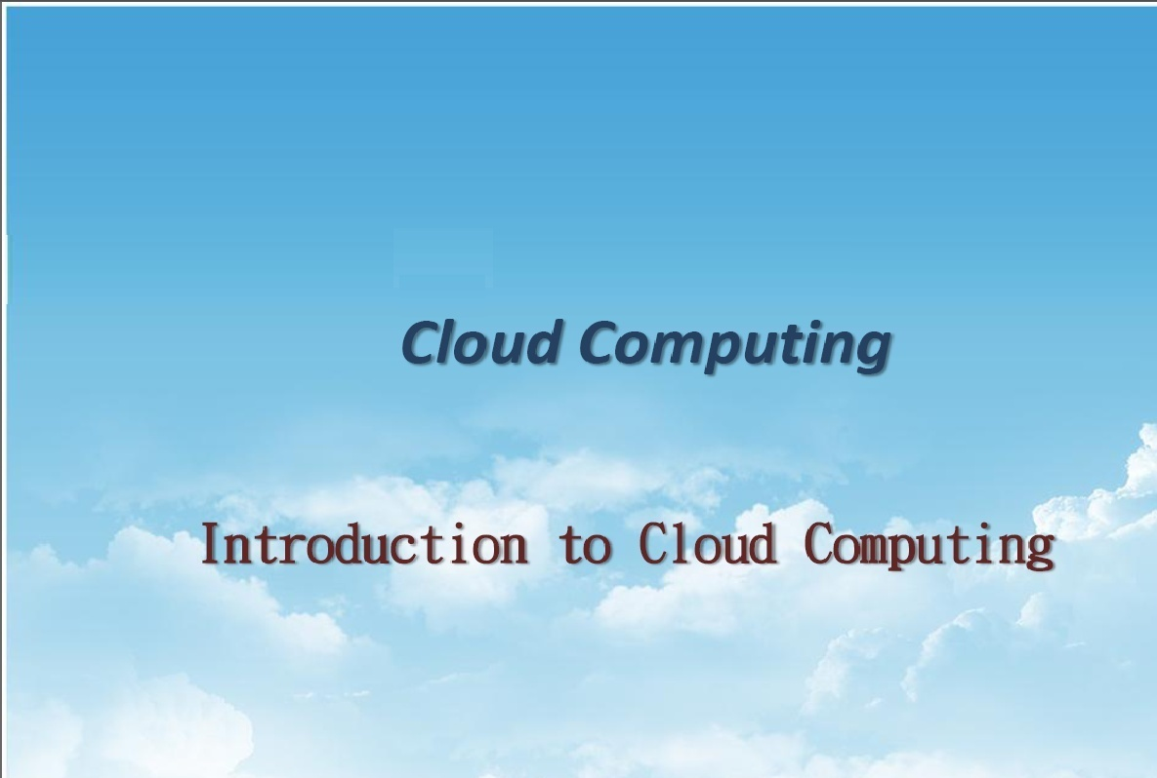
UNIT - I

Slide 3
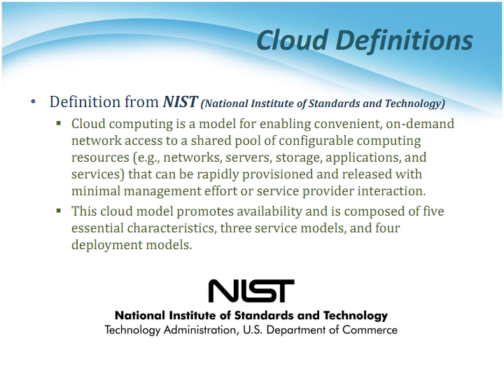
Resource provisioning with minimal service provider interaction.

Slide 4
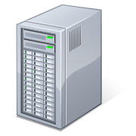
What is Cloud Computing
Shared pool of configurable computing resources
On-demand network access
Provisioned by the Service Provider
Applications
Services
Computer Network
Storage (Database)
SERvers
Adopted from: Effectively and Securely Using the Cloud Computing Paradigm by peter Mell, Tim Grance

Slide 5
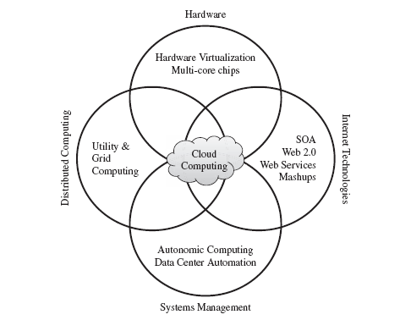
ROOTS OF CLOUD COMPUTING
From Mainframes to Clouds
SOA, Web Services, Web 2.0, and Mashups
Grid Computing
Utility Computing
Virtual Appliances and the Open Virtualization Format
Autonomic Computing

Slide 6
Service Oriented Computing
Service orientation is the core reference model for cloud computing systems.
A service is an abstraction representing a self-describing and platform-agnostic component that can perform any function—anything from a simple function to a complex business process.
A service is supposed to be loosely coupled, reusable, programming language independent, and location transparent.
Services are composed and aggregated into a service-oriented architecture (SOA) , which is a logical way of organizing software systems to provide end users or other entities distributed over the network with services through published and discoverable interfaces
Service-oriented computing introduces and diffuses two important concepts, which are also fundamental to cloud computing: quality of service (QoS) and Software-as-a-Service (SaaS)
One of the most popular expressions of service orientation is represented by Web Services (WS). These introduce the concepts of SOC into the World Wide Web, by making it consumable by applications and not only humans.

Slide 7
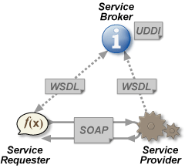
What is a Web Service?
W3C
Web services are web application components.
SOAP is XML based protocol for accessing web services and exchanging info.
WSDL(Web Service Description Language) is XML based language for describing web services.
UDDI(Universal Description Discovery and Integration) is a directory service where companies can search for Web services.
UDDI communicates via SOAP
Notes:
SOAP – Simple Object Access Protocol
WSDL- Web Service Description Language
UDDI - Universal Description, Discovery and Integration (UDDI)

Slide 8
What is a Web Service?
Web Services can convert your application into a Web-application, which can publish its function or message to the rest of the world. Web services allow different applications from different sources to communicate with each other without time-consuming custom coding, and because all communication is in XML, Web services are not tied to any one operating system or programming language
For example , Java can talk with Perl, Windows applications can talk with UNIX applications . Unlike traditional client/server models, such as a Web server/Web page system, Web services do not provide the user with a GUI. Web services instead share business logic, data and processes through a programmatic interface across a network.

Slide 9
Utility Computing and Grid Computing
Utility computing is the packaging of computing resources, such as computation, storage and services, as a metered service. This model has the advantage of a low or no initial cost to acquire computer resources; instead, computational resources are essentially rented.
This repackaging of computing services became the foundation of the shift to "on demand" computing.
Grid Computing is Grid computing enables aggregation of distributed resources and transparently access to them.
Most production grids such as TeraGrid and EGEE seek to share compute and storage resources distributed across different
administrative domains, with their main focus being speeding up a broad range of scientific applications, such as climate modeling, drug design, and protein analysis.

Slide 10
Essential Characteristics
Self-Service
Per-Usage Metering and Billing
Elasticity
Customization

Slide 11
Cloud Characteristics
On demand self service
- made available in couple of minutes.
- without service provider interaction(in SaaS) ex. email
Broad Network Access
- Over network accessed through thin or thick client platforms (mobile phones, laptops,PDAs)
- Private cloud, public cloud and Hybrid cloud

Slide 12
Rapid Elasticity
Provisioned or released as per on – demand.
Make sure of exact capacity , an application demands.
Scalability
Measured Service
Monitored resource usage - Pay per use.
Reserved / Spot / On demand instances
Optimized resources( In AWS, c1. small, medium , large, m2, g2)

Slide 13
Customization
Multitenancy
Single instance of resource giving access to multiple organization (tenants).
Virtualized access.
In the case of infrastructure services, customization means allowing users to deploy specialized virtual appliances and to be given privileged (root) access to the virtual servers. Other service classes (PaaS and SaaS) offer less flexibility and are not suitable for general-purpose computing [5], but still are expected to provide a certain level of customization.
Virtualization uses software that simulates hardware functionality to create a virtual system. This practice allows IT organizations to operate multiple operating systems, more than one virtual system and various applications on a single server. The benefits of virtualization include greater efficiencies and economies of scale.

Slide 14
Cloud Characteristics -Advanced Features
Virtualization Support.
Self-Service, On-Demand Resource Provisioning
Multiple Backend Hypervisors.
(A hypervisor, also known as a virtual machine monitor or VMM, is software that creates and runs virtual machines (VMs).)
Storage Virtualization.
Interface to Public Clouds.
Virtual Networking.
Dynamic Resource Allocation.
Virtual Clusters.
Reservation and Negotiation Mechanism.
High Availability and Data Recovery.

Slide 15
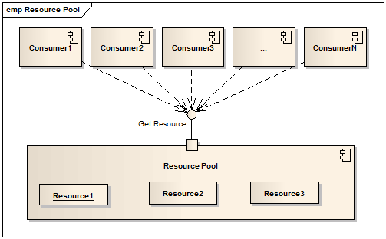
Resource Pooling
Resources are pooled to serve multiple consumers using a multitenant model.
Dynamically assigned and reassigned as per consumer’s demand.
(Location Independence)
Able to specify location at a higher level of abstraction(Country, state or datacenter) like in AWS. (US East, west, oregano)

Slide 16
Benefits of Cloud Computing(Vs Traditional Computing)
No up-front commitments, Reduced Cost
On-demand access
Nice pricing
Simplified application acceleration and scalability
Efficient resource allocation
Energy efficiency
Seamless creation and use of third-party services

Slide 17
Cloud Service Offerings
Cloud service offerings are classified into three models which are
SaaS (Software as a Service)
PaaS (Platform as a Service)
IaaS (Infrastructure as a Service)

Slide 18
SaaS
Common SaaS Use-Case: Replaces traditional on-device software
In this the provider’s application are running on the cloud infrastructure.
The application are accessible from various client devices through a thin client interface such as a web browser.
The consumer does not manage or control the underlying cloud infrastructure including network, servers, operating systems, storage, or even individual application capabilities, with the possible exception of limited user-specific application configuration settings.
Examples : Workday(ERP for HR), Concur(expense mgmt), Citrix GoToMeeting/Cisco WebEx(online meetings and video conferencing)

Slide 19
Benefits of SaaS
1.Reduced time to benefit
.
2. Lower Cost
3. New releases (upgrades)
4.Easy to use
5. Any time & any where access

Slide 20
Challenges
Data Availability
Governance & billing Mgmt
Need of good connectivity
Synchronization of client & vendor migration(vendor lock-in)

Slide 21
PaaS(Platform as a Service)
Web appl envi, os instances, database, middlewares.
Used to develop cloud – ready application.
Providers PL& Tools:The capability provided to the consumer is to deploy consumer-created or acquired applications (created using programming languages and tools supported by the provider) on the cloud infrastructure.
Common PaaS Use-Case: Increases developer productivity and utilization rates
Only deploy code : The consumer does not manage or control the underlying cloud infrastructure, including network, servers, operating systems, or storage, but has control over the deployed applications and possibly application hosting environment configurations.
Google App Engine, Microsoft Azure, and Force.com are foremost examples of platform as a service.

Slide 22
Benefits of PaaS
Enables developer to focus on appl code & business logic
Natural fit for development, testing & production environments
Take Less time
Scalable without delay
Eliminate the complexities of h/w & s/w dependencies

Slide 23
Challenges of PaaS
Risk of vendor lock-in
Interoperability & connectivity with existing on-premises appl
Rely on third party performance & scalability SLAs
Potential security risk & loss of control over the data
GAE, Force.com, hureko, cloud foundry

Slide 24
IaaS
The capability provided to the consumer is to provision processing, servers, storage, networks, and other fundamental computing resources where the consumer is able to deploy and run arbitrary software, which can include operating systems and applications.
Common IaaS Use-Case: Extends current data center infrastructure for temporary workloads (e.g. increased Christmas holiday site traffic)
The consumer does not manage or control the underlying cloud infrastructure but has control over operating systems, deployed applications, and possibly limited control of select networking components for example host firewalls.
Examples :Amazon Web Services (AWS), Cisco Metapod, Microsoft Azure, Google Compute Engine (GCE), Joyent

Slide 25
Benefits of IaaS
Effective infrastructure utilization
Highly automated resulting in faster provisioning of resources
Easily meet the changing demand for consumption
Reduced cost due to less h/w resources
, space, power consumption.

Slide 26
Challenges of IaaS
Migration of data
Need of good connectivity
Vendor reliability & security risk
Difficult to make a gateway for integrating in-premise , firewall protected appl with appl on public cloud.
Ex. AWS rackspace cloud hosting

Slide 27
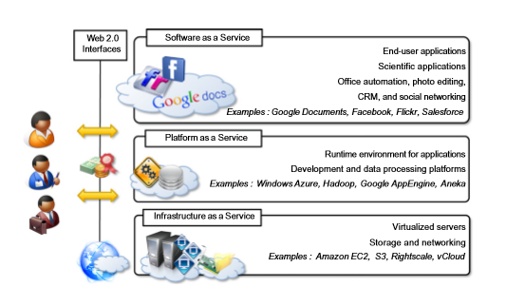
Cloud Computing Reference Model

Slide 28
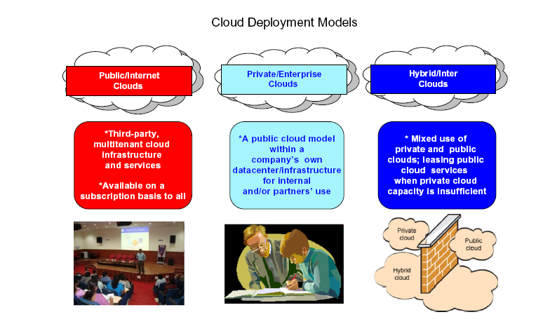
Deployment Models(Organizational Scenario)
An agency can deploy cloud computing in several different ways depending upon many factors, such as:
Where the cloud services are hosted
Security requirements
Desire to share cloud services
The ability to manage some or all of the services
Customization capabilities
There are four common deployment models for cloud services loosely determined by who has access to the cloud services: Public Cloud, Private Cloud, Community Cloud, and Hybrid Cloud.

Slide 29
Public cloud
Available to the general public and is owned by a third party cloud service provider (CSP).
An agency dynamically provisions computing resources over the Internet from a CSP who shares its resources with other organizations.
The CSP bills the agency for its share of resources used similar to that of an electric utility.
Cost effective deployment model for agencies as it gives them the flexibility to procure only the computing resources they need
Services are delivered with consistent availability, resiliency, security, and manageability.
Nevertheless, to benefit from a public cloud, an agency must accept reduced control and monitoring over the provider’s governance and security.

Slide 30
Private cloud
Operated solely for a single organization or agency: the CSP dedicates specific cloud services to that agency and no other clients.
The agency specifies, architects, and controls a pool of computing resources that the CSP delivers as a standardized set of services.
A common reason for agencies to procure private clouds is their ability to enforce their data security standards and controls.
An agency will typically host a private cloud on-premises, connect to it through private network links, and only share its resources within the agency.
Because resources are not pooled across multiple unaffiliated organizations, an agency will pay for all of the cloud's capacity.
Nevertheless, the agency's Chief Information Officer (CIO) can provide these resources as services on-demand to organizations and programs within the agency and charge them accordingly.

Slide 31
Community cloud
Procured jointly by several agencies or programs that share specific needs such as security, compliance, or jurisdiction considerations.
The agencies or CSP may manage the community cloud and it may exist on-premises or off-premises.
Enables agencies with common set of requirements to combine assets and share computing resources, data, and capabilities.
By eliminating the duplication of similar systems, agencies can save money and more efficiently allocate their scarce resources.
Procuring a community cloud is also a way that an agency can advance the Federal IT Shared Service Strategy.

Slide 32
Hybrid cloud
Comprises two or more clouds (private, community, or public) with a mix of both internally and externally hosted services.
Agencies will likely not limit themselves to one cloud deployment but will rather incorporate different and overlapping cloud services to meet their unique requirements.
Hybrid deployment models are complex and require careful planning to execute and manage especially when communication between two different cloud deployments is necessary.

Slide 33
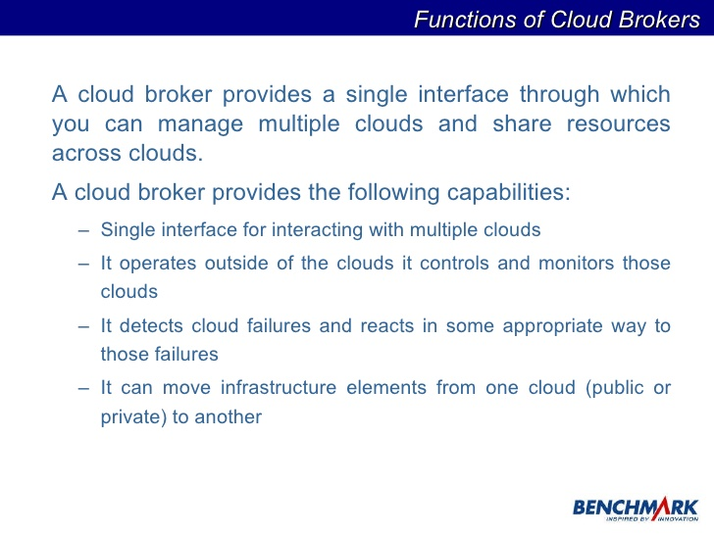
Cloud Service Brokerage (CSB)
CSB system plays a brokering role between CSP and CSC(cloud service commerce).
Upon receiving requirements of CSC, CSB validates service requirements to establish service selection plan and selects optimum service through service assignment negotiation & selection process.
The selected service is assigned to cloud through service assignment process to manage the assigned service

Slide 34
Role of Networks in Cloud Computing
The network plays a key role in the delivery of cloud-based services as it provides a means to connect every IT system and has the ability to provision and scale these resources to meet application and end-user requirements. It also is one of strategic element used for management of security objectives in the cloud as it:
Enables infrastructure enhancements by supporting server consolidation, virtualized environment, automated infrastructure and support application mobility.
Addresses access requirements emerging from thin clients or organization mobility requirements which may extend to any device at any time from any place.
Offers application analytics by clustering requirements and enabling remote usage or community services
Supports varied traffic patterns through location independent endpoints while ensuring automated provisioning and orchestration.

Slide 35
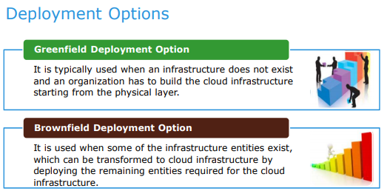

Slide 36
The Greenfield and Brownfield Deployment Options
Most of the companies moving to the cloud platform either choose to get rid of
(or scrap)their existing on premise infrastructure and choose cloud or combine on
premise and cloud defining such a process by which both are optimally utilized.
Before building a cloud infrastructure, organizations must identify which deployment option
is appropriate for them. There are two deployment options for building a cloud infrastructure
Greenfield deployment option and
Brownfield deployment option.
Greenfield means deploying completely new infrastructure from scratch , the entire
process of designing, developing, deploying, monitoring and management is involved.
The Brownfield is making changes in the existing infrastructure, a brownfield deployment
option is used when some of the infrastructure entities exist, which can be transformed to a
cloud infrastructure by deploying the remaining entities required for the cloud infrastructure.

